Slide 1
LECTURE 6: Transmission modes in communication channels
Three popular transmission modes:
Simplex,
Half Duplex
Full Duplex (Duplex)

Slide 2
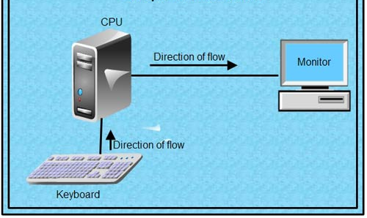
Simplex transmission mode
In simplex transmission mode, transmission is in one direction only.

Slide 3
The nature of transmission is:
one is a transmitter
the other a receiver.
Examples:
Radio and television broadcasts
(other typical examples of simplex transmissions)

Slide 4
Half duplex transmission
In this transmission mode:
transmission is in both directions but not simultaneous
- transmitter and receiver take turns to transmit

Slide 5
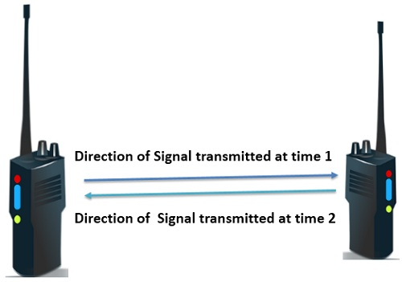
Typical examples

Slide 6
A walkie-talkie is one typical example
-uses a push button to allow one speaker to talk at a time.
- is also called a two wire circuit, where one wire is used for sending and the other for transmitting.

Slide 7
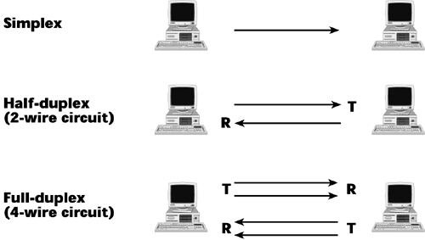

Slide 8
Full duplex (Duplex) transmission
transmission is in both directions and simultaneously.
It is also called a four wire circuit.

Slide 9
Limitation of real hardware in data transmission
Three important measures of performance used to assess transmission media are:
Channel capacity
Propagation delay
Signal levels used

Slide 10
The major objective transmission:
is to transmit as much data as possible in the shortest possible time.
To achieve this objective, the relationship between bandwidth of a transmission medium and its capacity becomes important.
This relationship was establish by Nyquist and is popularly known as Nyquist theorem.

Slide 11
This theorem provides the theoretical bound on the maximum number of bits (rate) at which data can be sent over a communication medium without considering the effect of noise.

Slide 12
Consider a transmission medium with K possible signal levels and an analog bandwidth B. Nyquist’s theorem states that the maximum data rate in bits per second, D can be calculated as:
D = 2B log₂K
Where B is the band width and K = signal levels

Slide 13
Example:
A noiseless channel has a bandwidth of 3000 Hz (3 kHz) and a signal with two levels.
The maximum bit rate D can be calculated as:
D = 2B log₂K
= 2 x 3000 x log₂ 2 = 2 x 3000 = 6000 bps
Two signal levels mean the use of two voltage levels to represent a logical 0 and a logical 1.

Slide 14
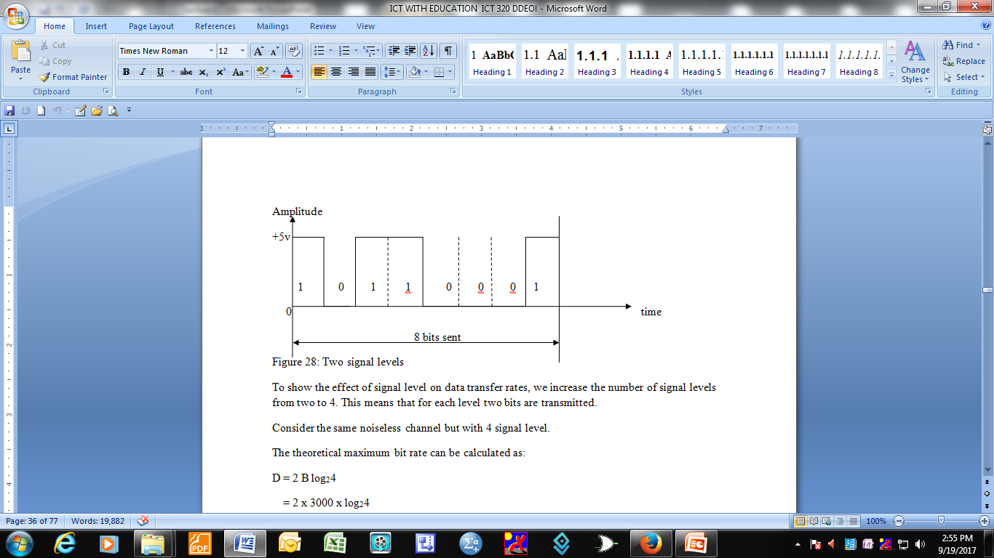

Slide 15
To show the effect of signal level on data transfer rates:
- we increase the number of signal levels from two to 4. This means that for each level two bits are transmitted.
Consider the same noiseless channel but with 4 signal level.
The theoretical maximum bit rate can be calculated as:

Slide 16
D = 2 B log₂4
= 2 x 3000 x log₂4
= 2 x 3000 x 2
= 12000bps

Slide 17
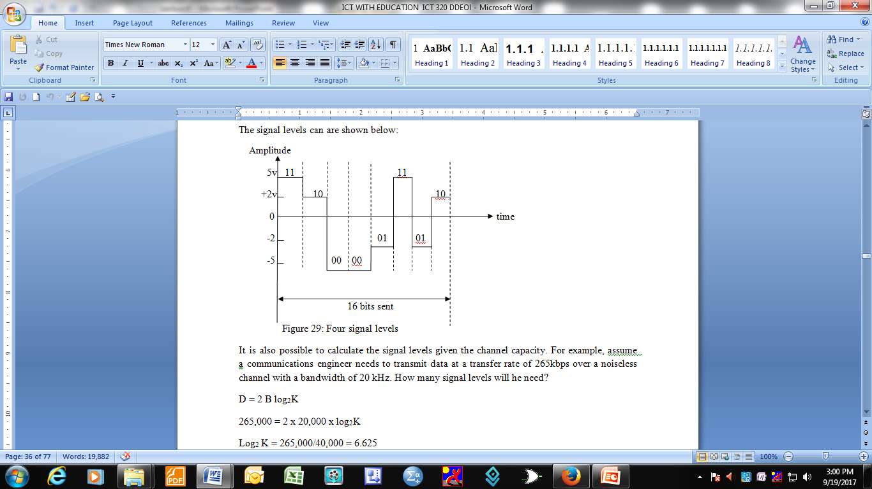

Slide 18
It is also possible to calculate the signal levels given the channel capacity.
For example, assume a communications engineer needs to transmit data at a transfer rate of 265kbps over a noiseless channel with a bandwidth of 20 kHz. How many signal levels will he need?

Slide 19
D = 2 B log₂K
265,000 = 2 x 20,000 x log₂K
Log₂ K = 265,000/40,000 = 6.625
K = 2^{6.625}
= 98.7K

Slide 20
The signal levels values are always a power of 2 but the above result of K is not a power of 2.
There is need to either increase the number of levels or reduce the bit rate.
If 128 levels are chosen, the bit rate will be 280Kbps. If a lover value is used say 64 levels is used, the bit rate will be 240 k bps.

Slide 21
The effect of noise on a communication channel
Nyquist theorem gives an absolute maximum that is not achievable in practice
This is because a communication channel is subject to some small amounts of electrical noise which cannot be eliminated.
Such noise makes it impossible to achieve the theoretical maximum transmission rate.

Slide 22
Claude Shannon
Shannon extended Nyquist theorem to specify maximum data rate that could be achieved over a transmission channel that experiences noise. This is known as Shannon’s theorem, and can be expressed as:
C = B log₂ (1 + (S/N)), where C is the effect limit on the channel capacity in bits per second; B is the hardware bandwidth and S/N is the signal to noise ratio.

Slide 23
Example of calculating channel capacity
Consider a transmission medium that has a bandwidth of 1 kHz, an average signal to power of 70 units and an average noise power of 10 units. Calculate channel capacity.
Channel capacity C is calculated as:
C = B log₂ (1 + S/N)
= 10³ x log₂ (1 + 7) = 10³ x 3 = 3000 bps.
The signal to noise ratio is often expressed in decibel(dB) and a decibel is defined as a measure of the difference between two power levels, for example

Slide 24
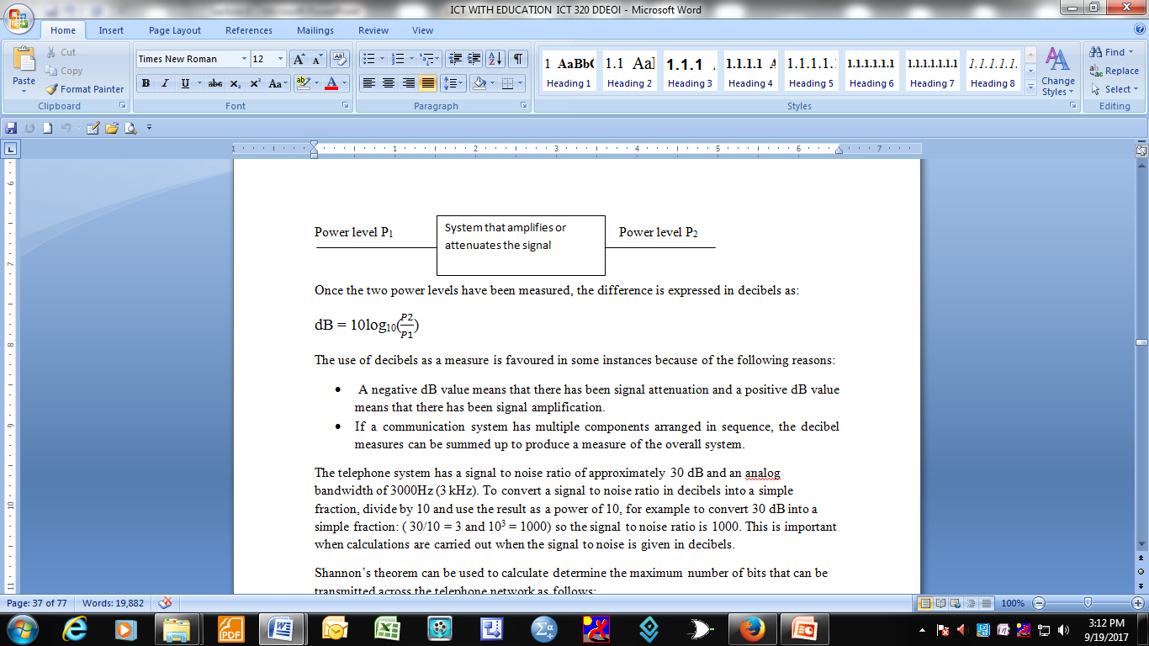

Slide 25
The use of decibels as a measure is favoured in some instances because of the following reasons:
A negative dB value means that there has been signal attenuation and
a positive dB value means that there has been signal amplification.
If a communication system has multiple components arranged in sequence, the decibel measures can be summed up to produce a measure of the overall system.

Slide 26
Example
The telephone system has a signal to noise ratio of approximately 30 dB and an analog bandwidth of 3000Hz (3 kHz).
To convert a signal to noise ratio in decibels into a simple fraction, divide by 10 and use the result as a power of 10, for example to convert 30 dB into a simple fraction: ( 30/10 = 3 and 10³ = 1000) so the signal to noise ratio is 1000. This is important when calculations are carried out when the signal to noise is given in decibels.

Slide 27
Shannon’s theorem can be used to calculate/determine the maximum number of bits that can be transmitted across the telephone network as follows:
C = B log₂ (1 + S/N)
= 3000 x log₂ (1+1000) ≈ 30,000 bps.

Slide 28
Example
A channel has a bandwidth of 1 MHz and a signal to noise ratio of 63. Calculate the appropriate bit rate and signal levels.
Solution
Use Shannon’s theorem to find the maximum limit:
C = B log₂ (1+S/N) = 10⁶ log₂ (1 + 63) = 10⁶ log₂64 = 10⁶ x 6 = 6 Mbps
Shannon’s theorem gives 6 Mbps, as the maximum of the channel. A lower upper limit such as 4 Mbps is preferred for a better channel performance. Shannon’s theorem does not operate with signal levels so Nyquist theorem is used to calculate the signal levels.
4 Mbps = 2 x 1 MHz log₂K
Log₂ K =
= 2
Log₂K = 2
K = 2² = 4 signal levels

Slide 29
Significance of Nyquist and Shannon ‘s theorems to DC engineers
Harry Nyquist and Claude Shannon’s theorems have consequences for engineers who design data communication networks.
Nyquist theorem has provided an incentive to explore complex or clever ways to encode bits on signals because a clever way of encoding allows more bits to be transmitted per unit time.

Slide 30
Shannon’s theorem is more fundamental as it informs engineers that no amount of clever encoding can overcome the laws of physics that place a fundamental limit on the number of bits per second that can be transmitted in a real communication system.

